Slide 1
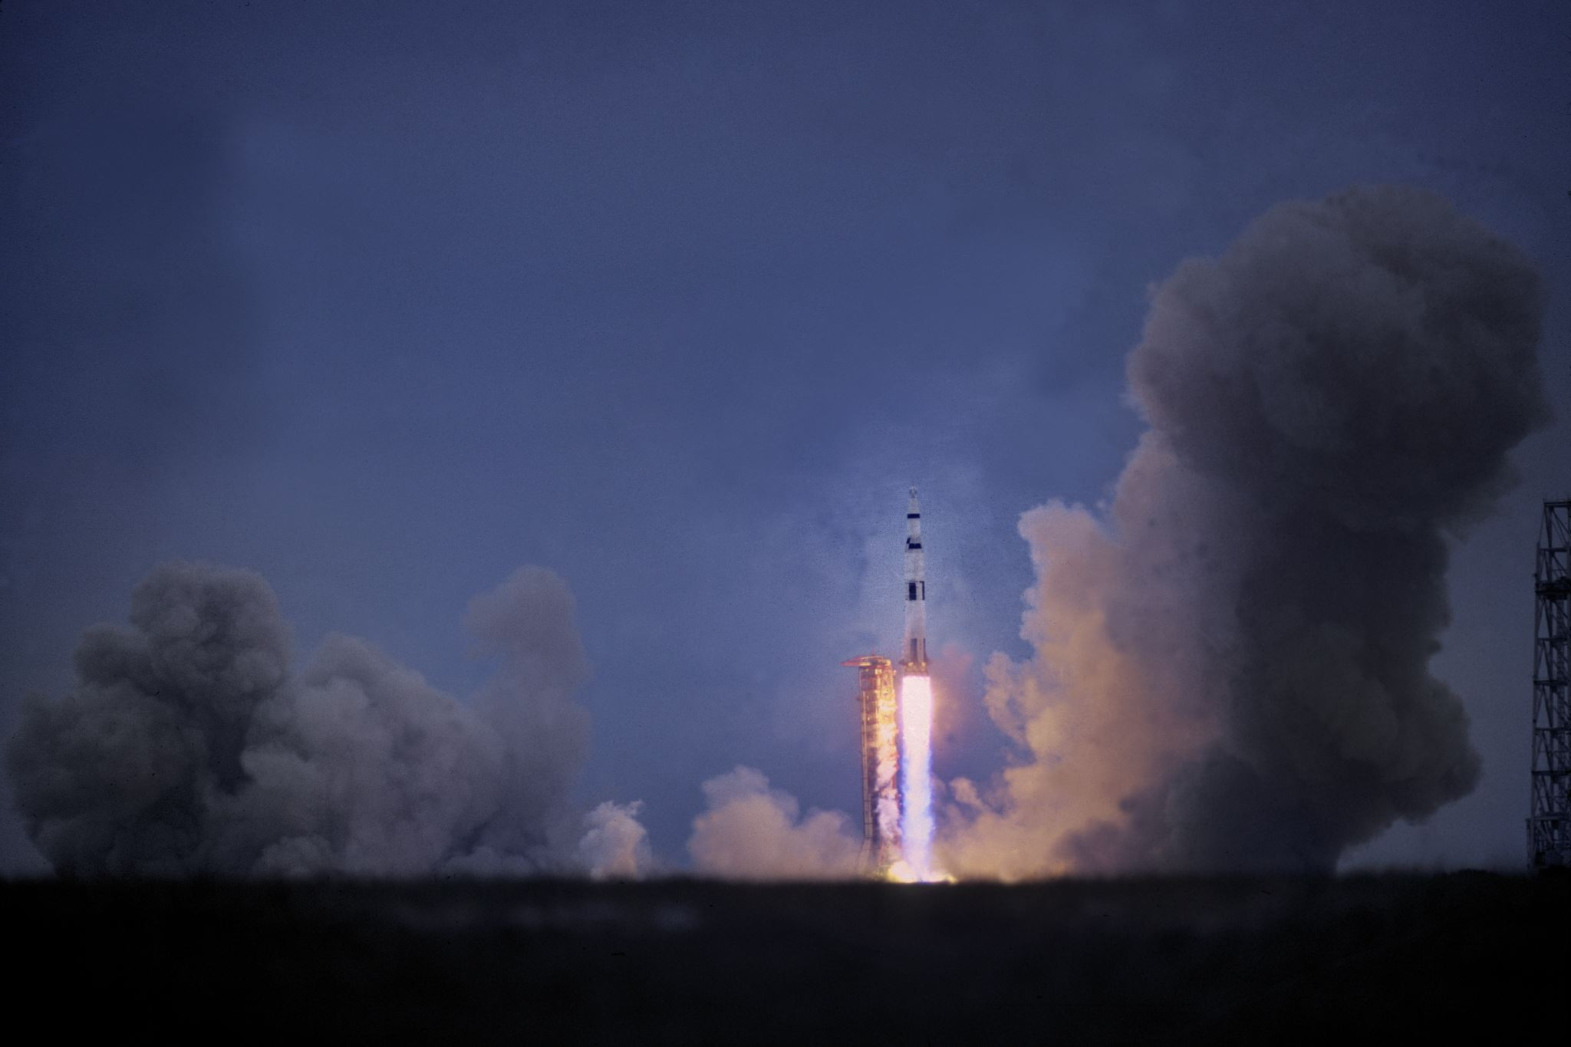
NASA Visualization

Slide 2

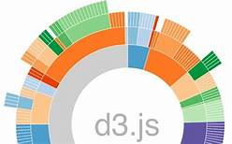



NASA Viz - Architecture
Asteroids
Planets
NASA

Slide 3
HTML: Create interactive web page with D3 visualizations
Create landing page for project
Utilize buttons to go to html of D3 in case data does not load
Created bootstrap carousel inn html that is able to hold D3 charts for interactive feature
Create CSS to style webpage
Edit JS codes from the charts to input them in the carousel
Hurdles: creating a carousel that was compatible with D3 charts was difficult
In the future, would use a vertical navigation bar or other features to toggle through the data easily

Slide 4
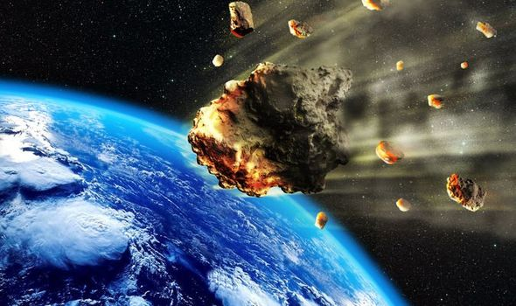
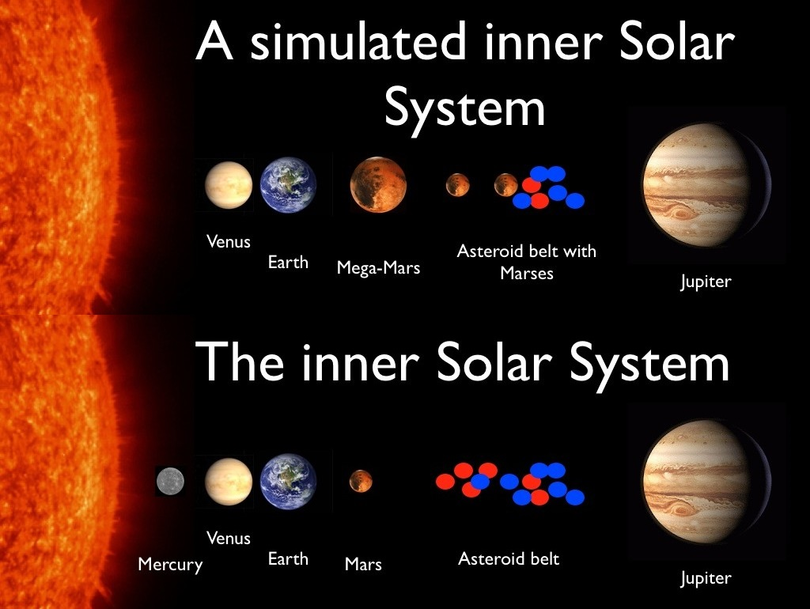
Motion Chart for Asteroids Activity
About Asteroids
Asteroids are minor planets, especially of the inner Solar System. Larger asteroids have also been called planetoids.
Asteroid belt is between Jupiter and Mars.

Slide 5
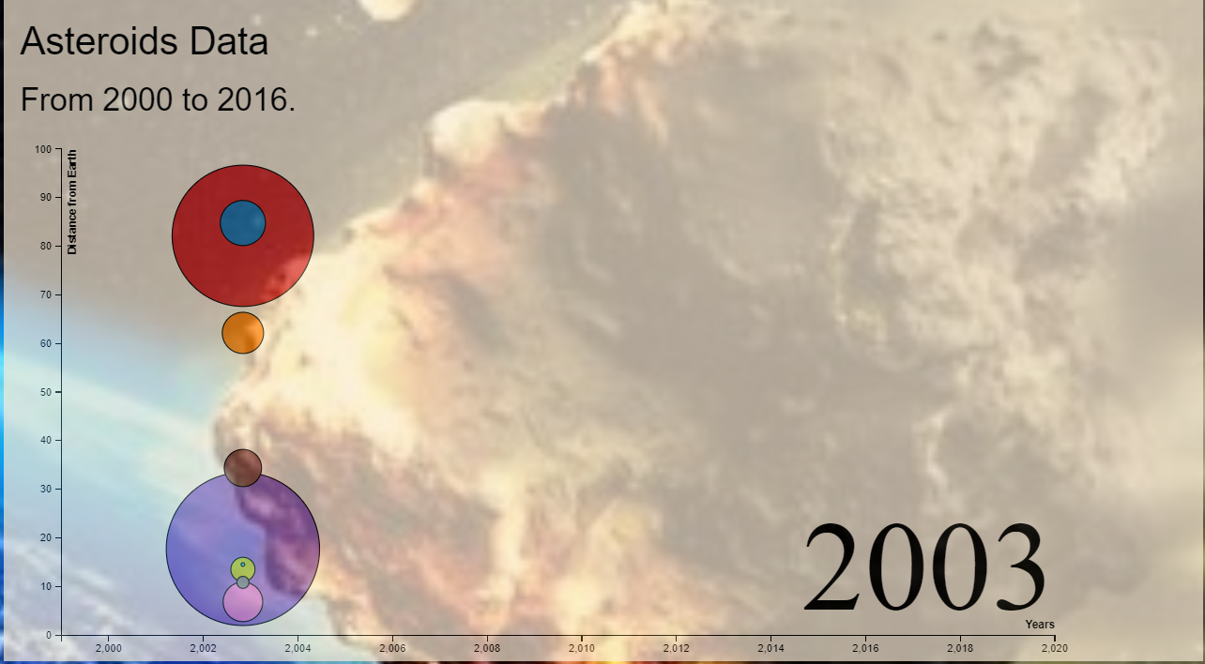
Motion Chart for Asteroids Activity
About Motion Chart
Data Dictionary:
Name
Diameter
Magnitude
Year
Distance from Earth

Slide 6
NASA Viz - Components
HTML homepage
Carousel JS library
Python powered flask web server used to
API based JSON download from NASA(https://api.nasa.gov/api.html)
Convered to XLS
Load into postgres database
Exportted to smaller XLS
HTML, css, Javascript and D3
Asterioids
Kepler systems and Planets
To switch between various views in the dashboard
Multiple visualizations of individual and combined datasets using new Javascript and D3 libraries

